Slide 1
Introduction to Billing
By
Arwa Dholkawala

Slide 2
What is a Billing System ?
An accounts receivable system that captures usage and billing data, computes product and service charges, applies discounts & taxes, generates a bill or an invoice and takes care of bill payment and user settlement.

Slide 3
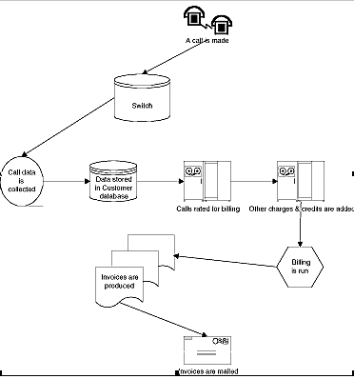
Example of Telephony Billing

Slide 4
Where does Billing fit into a typical OSS framework
Customer Care, Customer Self Care, Order Mgmt,Subscriber Mgmt, Services & Products,Pricing, Credit Check,Trouble Ticketing,
OSS MODULES
N/w
M
A
N
A
G
E
R
PROVISIONING
Bill
Formatter
W
I
R
E
L
I
N
E
N/W
E
L
E
M
E
N
T
S
M
E
D
I
A
T
I
O
N
Rating
Billing
W
I
R
E
L
E
S
S
Taxware
C
A
B
L
E
Accounting
Invoicing
Services such as Wireless, Wireline, IP, Broadband
SLA
Management
Fraud
Management

Slide 5
Billing System Functionality
System Administration
Account Management
    Account Creation for the Subscriber
    Defining Hierarchy
    Defining and Identifying Billable account
    Creating Service Contracts
    Problem History or Trouble Ticket Information
    Usage Details and Bill Information
    Query/Search
Services & Product Definition

Slide 6
Billing System Functionality …contd.
Prices & Discounts Definition
    Define Charges
      Usage Charges
      Recurring Charges
      Non Recurring Charges
    Define Rates
      Flat Rate
      Tiered Rate
      Threshold Rate
Rating
Billing
Invoicing
Payment Handling, Account Receivables & Settlement
Reporting

Slide 7

Overview of a typical billing process
End User
2. Authorization & Authentication
Network Element Management & Network Elements
3.Usage Data
Aggregate
Network Data
Management
Collate
Collect
4. Aggregated Usage Data
Discount
SLA Violations
Rating & Discounting
Rate
Special Discounts
Invoicing & Collections
Collect
Subscriber &
Order
Management
Invoice
1. Activate Customer Account
Billing Cycle
6. Generate Bills
7. Billing inquiry & Payments
End User

Slide 8
Billing Process Flow
Customer Account Management
Account/Service Activation
Authentication, Authorization and Accounting
Rating
Billing
Invoicing, Payment & Settlement

Slide 9
Two Types of Billing Models
Batch Processing Model
Real Time Processing Model

Slide 10
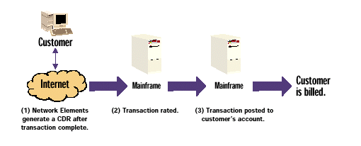
The Batch Processing Model
Data Flow in a Batch System

Slide 11
Limitations of the batch Model for Internet Services
Instantaneous Customer Data validation and configuration of the network elements
Authentication
Authorization
Service provisioning
Real Time Customer Self Help

Slide 12
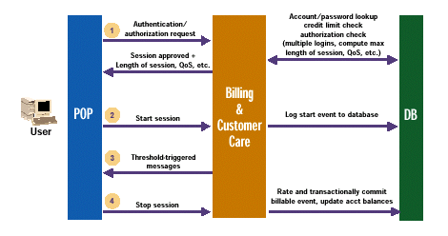
Real Time Processing Model

Slide 13
Benefits of Real Time Billing
Revenue Assurance, Bad debt Prevention
Advanced fraud protection
Offer credit enforcement in real time
Reduce customer service costs
Market to customers online
Customer Self-Service

Slide 14
Complicacies of Real Time Billing
Fault Tolerance / Failure Recovery
Performance
Tight Integration of network elements with the OSS and billing system

Slide 15
What is Warm Billing
In Warm Billing the service usage data is stored in an offline store over a fixed period of time. At the end of the fixed period the CDR batch is loaded and the CDRs are processed and a bill is generated and sent to the customer

Slide 16
What is Hot Billing
Hot Billing is the process to produce a bill immediately after a call release. The calculation input for this is the information from the CDRs produces during the call. The CDRs and service usage messages received directly from the switch are immediately applied to the customer accounts and rated in accordance with the customer’s individual pricing plan. The result is an up-to-date picture of customer usage activity and corresponding billing information.

Slide 17
Conclusion
Microsoft has migrated MCIS from a batch to real system
Cisco is developing DEN to address real-time provisioning
Dynamic provisioning makes real-time billing systems as the best choice for future. Such systems are hard and complicated to build. Fault tolerance, performance and scalability will come with a price. Also other considerations need to be looked upon such as is the system open and scalable to keep up with the new, next generation applications and network technologies.

Slide 18
Thank You

